Slide 1
BUZ Instructions Sign In

Slide 2
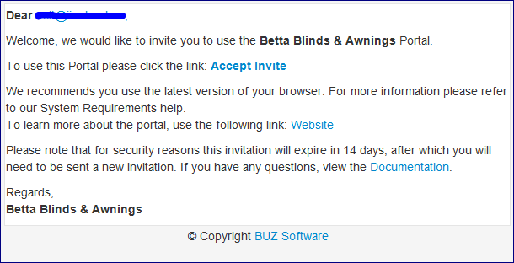
Welcome to a new way to place an order
You will be sent an email with an invite (as below)
Simply accept the invite by Clicking on “Accept invite”
You will then be taken to your Information Page
Fill in your details and Select Register

Slide 3
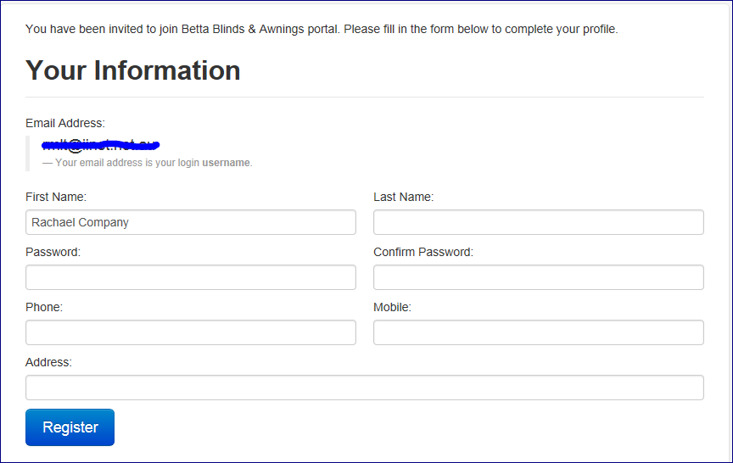

Slide 4
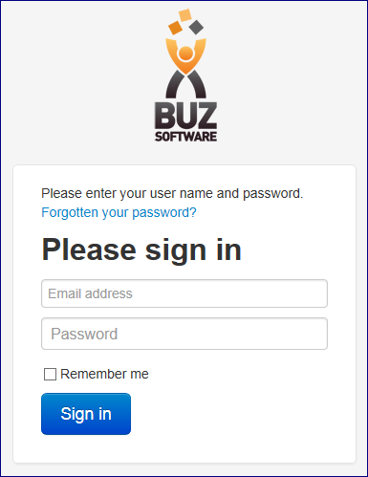
Login
Go to login.buzsoftware.com.au and sign in with your User Name and Password
Select Forgotten your password if you can not remember it, this will take you to a new window where you can re-set your password

Slide 5
Home Page
Once you have logged in you will see your home page, if you have more than one Company you can choose from them here
You can also access your Profile to change your Contact Details or Password by selecting the My Profile TAB at the top
The above headings will be on the top right of your page and will allow you to
Log Off
Return to the home page with My Buz
Access our Help pages or contact us with your help questions by dropping down the menu next to Help

Slide 6
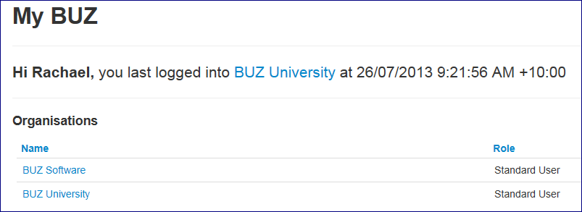
Select your Company
If you have more than one company that you can order from using BUZ Software they will appear in this list for you to choose from
Select the company you want and happy ordering

Slide 7
Thank you Any further questions please contact us at support@buzsoftware.com.au

